Slide 1
Introduction to Islandora
NYCIslandora Working Group

Slide 2
Introduction to Islandora
February 19, 2018
NYC Islandora Working Group
Notes:
Welcome! We’re excited to have your here.
Before we get started, please introduce yourself. Tell us your name, institution, what you hope to gain today, and your experience with Islandora.

Slide 3
Agenda
Introduction to NYC Islandora Working Group
Getting Started:
What is Islandora?
Islandora Resources
Islandora Administration
How do we use Islandora
Demos
Discussion & Questions
Notes:
How many people have heard of or used Islandora?
Are you interested in the backend development of the system, the frontend administration, or some combination of both?

Slide 4
NYC Islandora Working Group
@NYCIslandora
Started February 2017; Monthly meeting (2 hours)
Local NYC community of cultural institutions
Active Members
Robin Naughton, Head of Digital, The New York Academy of Medicine
Diego Pino Navarro, Software Developer, Metropolitan New York Library Council
Thomas Cleary, Archivist, LaGuardia Community College
Henry Raine, Director of the Library Digital Program and Institutional Digital Repository, New-York Historical Society
Martha Tenney, Digital Archivist, Barnard College

Slide 5
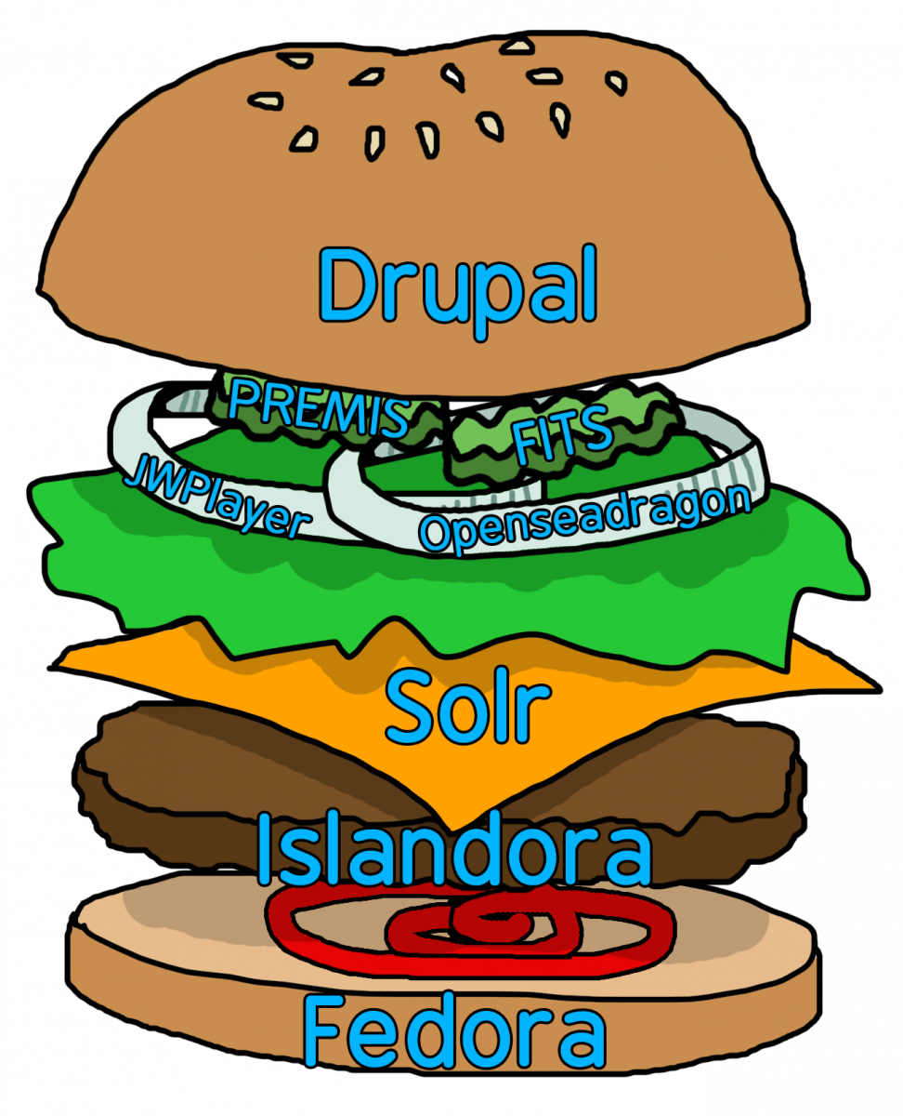
Getting Started: What is Islandora?
Developed by the University of Prince Edward Island’s Robertson Library (2006)
Open-source framework
Fedora - Digital Repository
Drupal - Content Management System (CMS)
Solr - Search platform
Solution Packs - Islandora modules
Active international community
Islandora Foundation

Slide 6
Getting Started: Islandora Resources
Islandora Foundation: https://islandora.ca/
Resources: https://islandora.ca/resources
Sandbox: https://islandora.ca/sandbox
Documentation:
Wiki: https://wiki.duraspace.org/display/ISLANDORA/Start
GitHub: https://github.com/Islandora
Bibliography: https://github.com/Islandora-Labs/islandora_bibliography
Multi-importer: https://github.com/mnylc/islandora_multi_importer
Web Annotations: https://github.com/digitalutsc/islandora_web_annotations

Slide 7
Getting Started: Islandora Administration
Structure
Collections within collections
Share resources across collections
Share resources across sites
Ingest
Individual item
Batch importer
Multi-importer
Solution Packs
Collection
Simple/Large Image
Book
Compound Object
Audio
Video
Newspapers
Manuscript, Oral History, etc, etc.
Search & Metadata
Notes:
Brief walk through the sandbox while discussing the sections.

Slide 8
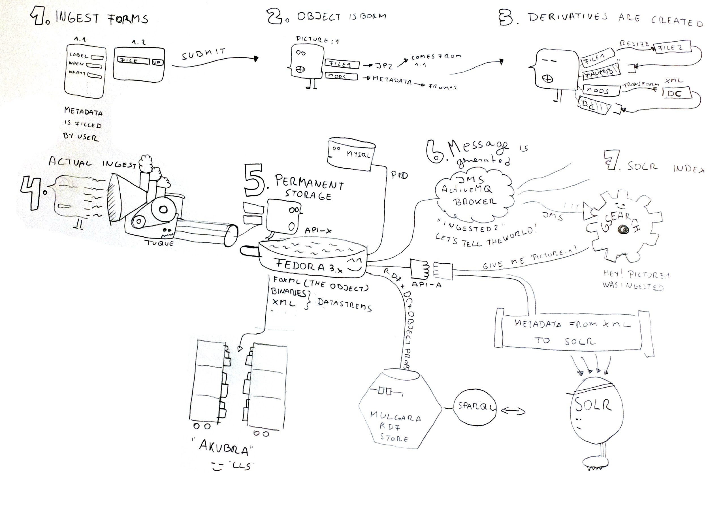
Getting Started: the life of an Islandora DO
Notes:
Explanation of all what happens when you ingest an Object (create an item)

Slide 9
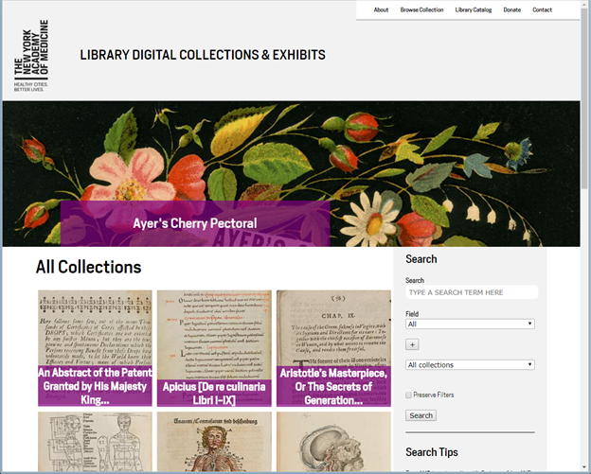
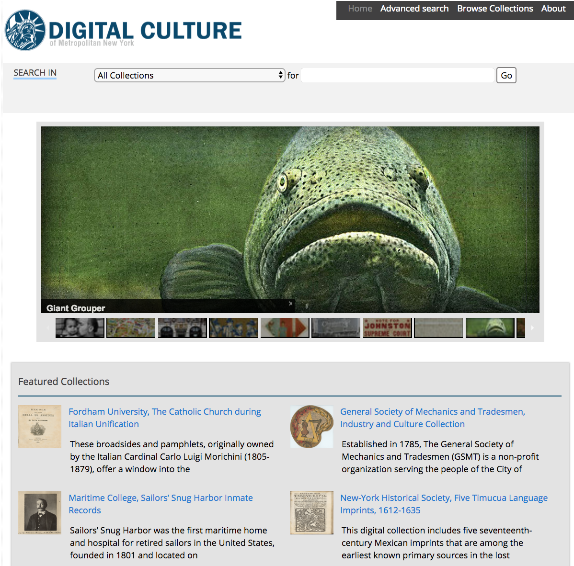
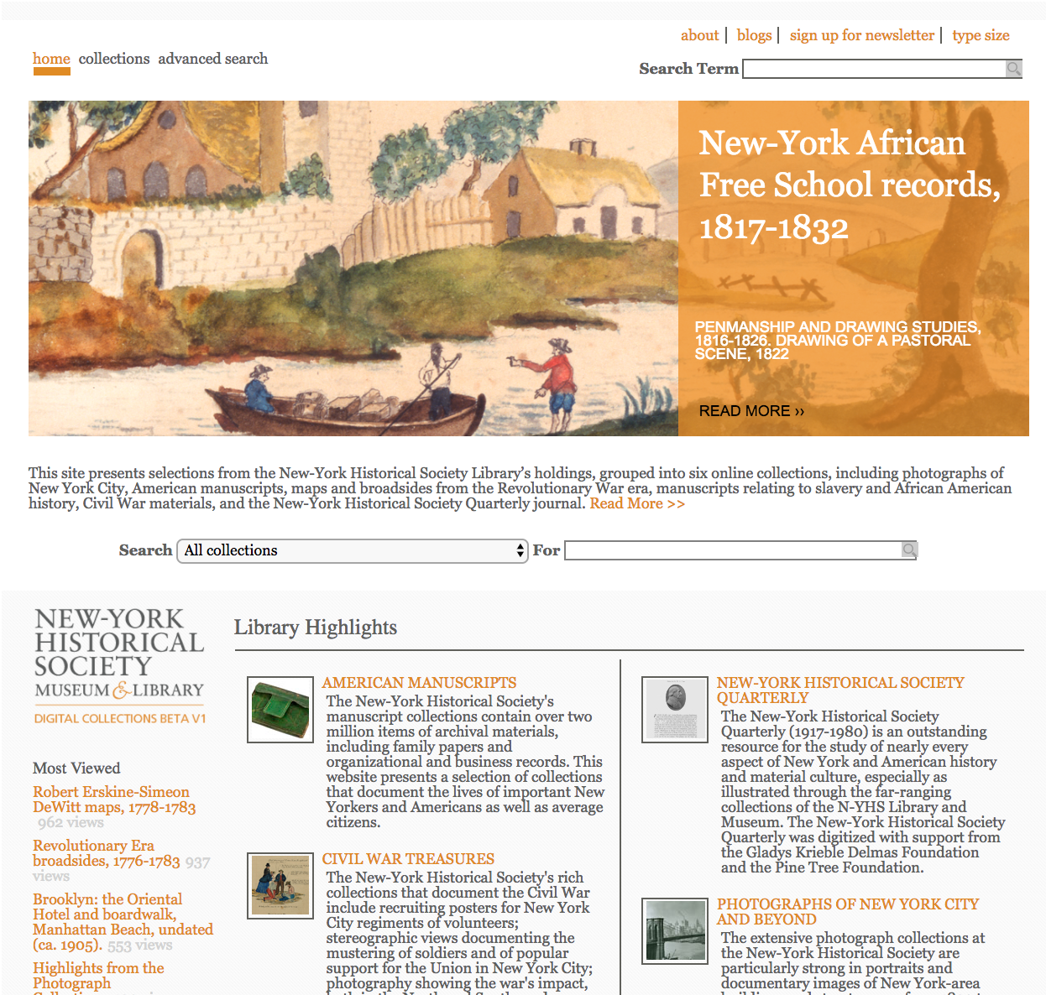
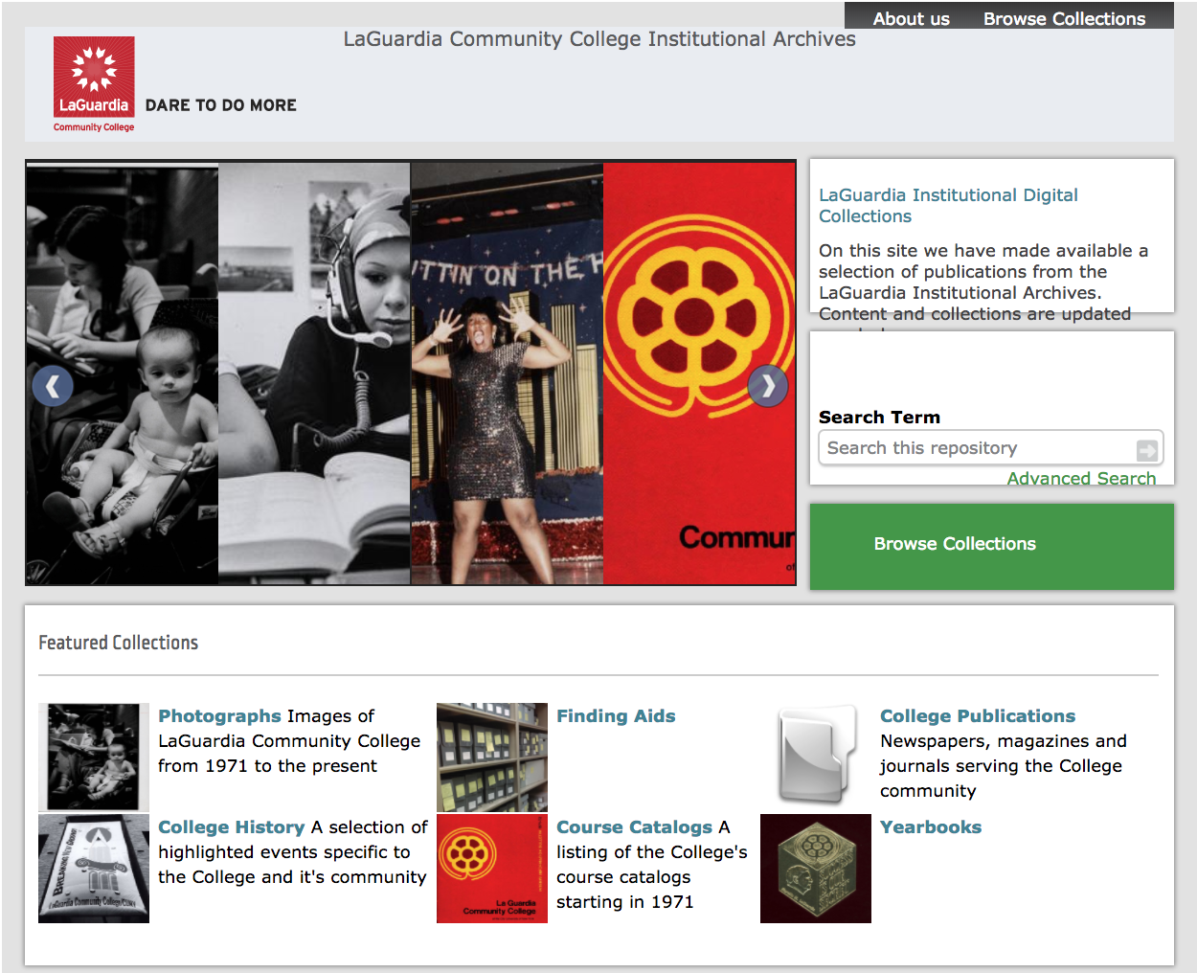
How do we use Islandora?

Slide 10
Demos
Admin interface. Drupal v/s Islandora
Creating an item (Digital Object)
Multi-importer
XML Forms/ Editing your Metadata
Solr facets and discovery
Exhibits pages

Slide 11
Discussion & Questions
What are some challenges with managing an Islandora site?
Open Source Communities scare me: if I go for Islandora, will I get help?

